Slide 1
Programming JAVA {
Hiveed.java
Class Object;
/* Here is where your journey for your dream begins */
}
JAVA Programming

Slide 2
Hiveed.java
What is Class :
A Class is a blueprint that defines the properties ( attributes ) and functionalities ( methods ) of object.
It act as template for creating object.
A Class have a constructor , which initialize object with Specific values.
JAVA Programming

Slide 3
Hiveed.java
What is Class :
Attributes - variables :
It represent the characteristics of an object , such as its color , size , or name.
Methods-Function :
These defines the action or behaviour that objectt of this class can perform.
JAVA Programming

Slide 4
Hiveed.java
What is Class :
Constructor :
It optional it can be executed when the object is created.
They are commam=nly used to set the object’s initial state by assigning values to its attributes.
JAVA Programming

Slide 5
Hiveed.java
What is Object :
It represent a real-world entity in the software field.
It is entity with attributes and behaviour defined by its class.
Multiple objects can be created from the single class.
Object can create a new block of memory in the heaparea.
JAVA Programming

Slide 6
Hiveed.java
Relation beteween the class and object :
A class serves as a blueprint for creating object.
An object is an instance of a Class.
Multiple objects can be created from the Single Class.
JAVA Programming

Slide 7
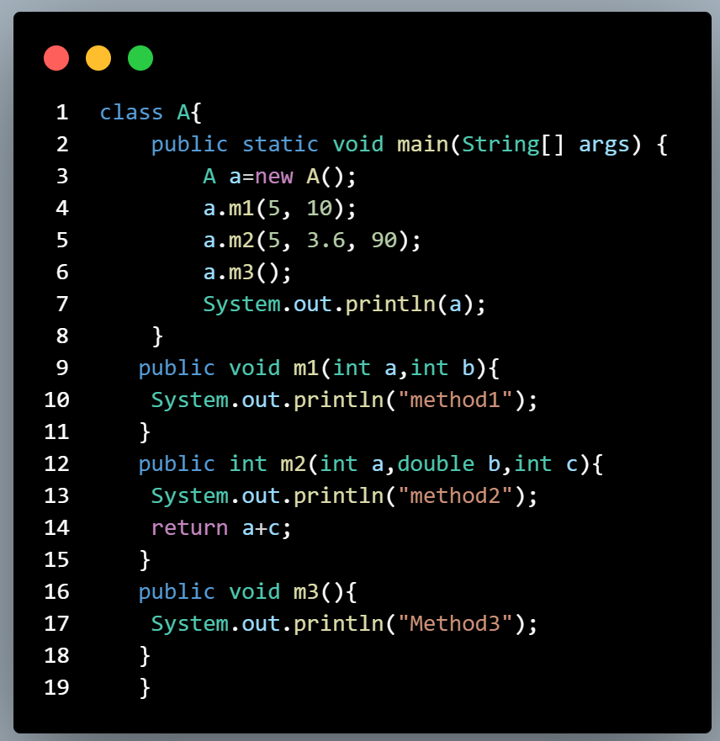
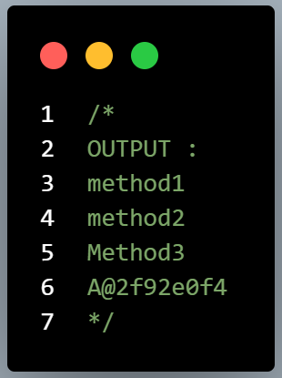
Hiveed.java
JAVA Programming

